Slide 1
Regression Analyses and Spatial Regression Methods
Understanding OLS vs. Spatial Methods

Slide 2
What is Regression Analysis?
Regression analysis is a statistical technique for estimating relationships between variables.
It helps to understand the influence of independent variables on a dependent variable.
Types of regression include:
- Simple Linear Regression
- Multiple Linear Regression
- Logistic Regression

Slide 3
Ordinary Least Squares (OLS) Regression
OLS is the most common method of regression analysis.
It minimizes the sum of squared differences between observed and predicted values.
Assumes independence of observations and homoscedasticity.

Slide 4
Limitations of OLS
OLS assumes independence of observations, which may not hold in spatial data.
OLS does not account for spatial autocorrelation (e.g., nearby regions might have similar values).

Slide 5
Overview of the Presentation
What is Regression Analysis?
Ordinary Least Squares (OLS) Regression: Basics and Assumptions
Spatial Regression Methods: Key Concepts
- Spatial Lag Model
- Spatial Error Model
Why Use Spatial Regression?
Comparison of OLS vs. Spatial Models

Slide 6
What is Regression Analysis?
Definition: A statistical technique used to examine the relationship between a dependent variable and one or more independent variables.
Purpose:
- Predict outcomes from independent variables.
- Assess the relationship strength and direction.
- Identify key predictors.
Types:
- Simple Linear Regression (1 independent variable)
- Multiple Regression (more than 1 independent variable)

Slide 7
Basic Regression Equation
General form of regression model:
Y = β₀ + β₁X₁ + β₂X₂ + ... + βₙXₙ + ϵ
• Y = Dependent variable
• X₁, X₂, ... Xₙ = Independent variables
• β₀ = Intercept
• β₁, β₂, ... βₙ = Coefficients
• ϵ = Error term

Slide 8
Interpreting Regression Coefficients
Coefficients measure how much Y changes for every unit increase in an independent variable.
Positive β: Increase in independent variable → increase in Y.
• Negative β: Increase in independent variable → decrease in Y.
• Example:
If β₁ = 0.5, a 1-unit increase in X₁ leads to a 0.5-unit increase in Y.

Slide 9
Ordinary Least Squares (OLS) Regression
• Objective: Minimize the sum of squared residuals for the best linear fit.
• Key Assumptions:
- No spatial autocorrelation in errors.
- Homoscedasticity (constant error variance).
- No multicollinearity.
• Equation:
Y = β₀ + β₁X₁ + β₂X₂ + ... + βₙXₙ + ϵ

Slide 10
Limitations of OLS Regression
• Independence Assumption: OLS assumes observations are independent—this is not true for spatial data.
• Potential Bias: Ignoring spatial dependence may lead to biased or inconsistent estimates.
• Examples: Housing prices, crime rates, etc.

Slide 11
What is Spatial Dependence?
• Definition: When values at one location depend on neighboring locations.
- Positive Spatial Autocorrelation: Similar values in nearby areas.
- Negative Spatial Autocorrelation: Dissimilar values in nearby areas.
• Implication: Ignoring spatial dependence can lead to incorrect conclusions.

Slide 12
Introduction to Spatial Regression
• Purpose: Accounts for spatial dependence by incorporating spatial structures.
• Main Models:
- Spatial Lag Model (SLM)
- Spatial Error Model (SEM)
• Why Use Spatial Regression? Better predictive accuracy through acknowledgment of spatial relationships.

Slide 13
Spatial Lag Model (SLM)
• When to Use: The dependent variable is influenced by its neighboring values.
• Key Concept: Incorporates neighboring dependent variables as predictors.
• Equation: Y = ρWY + Xβ + ϵ
- ρ: Spatial autoregressive parameter
- W: Spatial weights matrix
- WY: Spatially lagged dependent variable

Slide 14
Spatial Error Model (SEM)
• When to Use: When spatial dependence is present in the error terms.
• Key Concept: Models spatially correlated errors to avoid bias.
• Equation: Y = Xβ + ϵ
ϵ = λWϵ + u
- λ: Spatial autoregressive parameter for the error term
- W: Spatial weights matrix

Slide 15
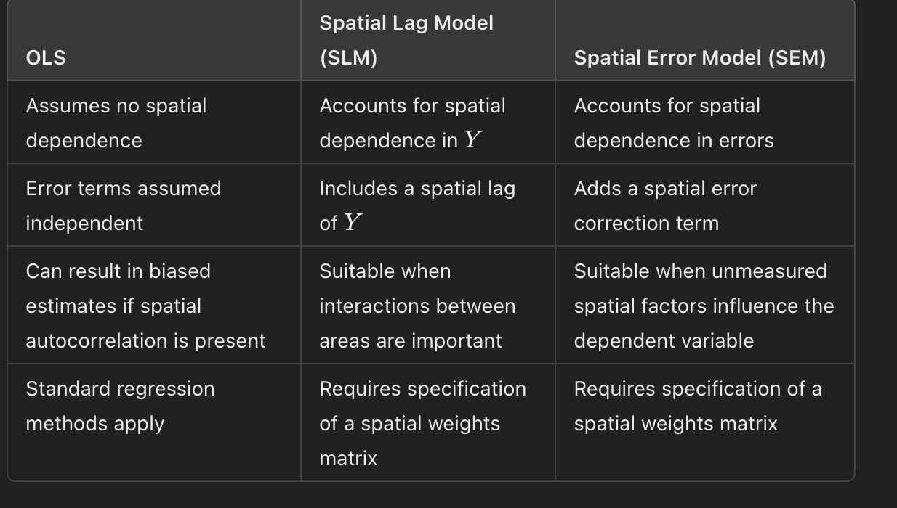

Slide 16
Why Use the Spatial Durbin Model?
Captures both local and spillover effects:
How your neighbors’ characteristics (WX) influence your outcome.
Direct effects: the effect of X on Y within a unit.
Indirect (spillover) effects: how X in neighboring units affects Y in your unit.
Useful when policy interventions or behaviors spill across borders (e.g., housing, crime, commuting patterns).

Slide 17
Interpreting Effects in SDM
Direct effect:
E.g., the % of residents working from home in Tract A increases as broadband access in Tract A increases.
Indirect effect (spillover):
E.g., broadband access in neighboring tracts also increases work-from-home rates in Tract A.
Total effect = Direct + Indirect

Slide 18
When Should I Use SDM?
You believe:
Y is influenced by neighbors' Y (spatial lag), and
X in neighbors influence Y (spatial X).
Examples:
Crime: A crackdown in one neighborhood pushes activity into adjacent areas.
Health behaviors: Vaccination rates or drug use cluster geographically.
Housing prices: Gentrification in one tract drives up prices nearby.

Slide 19
Why Spatial Models?
Traditional regression assumes independence between observations.
In spatial data, nearby units are often correlated:
e.g., neighboring census tracts may have similar work-from-home rates.
Ignoring spatial dependence can bias estimates and understate standard errors.

Slide 20
Why Use Spatial Regression?
• Corrects for Spatial Dependence: Provides more accurate models.
• Better Model Fit: Spatial models often show better performance (higher R², lower AIC/BIC).
• Policy Implications: Particularly useful in housing, health, and other areas where location matters.

Slide 21
Application Example
• Dependent Variable: Work from Home
• OLS Model: Does not account for spatial autocorrelation.
• Spatial Lag Model: Improves model fit by including neighboring regions' influence.
• Spatial Error Model: Corrects for local spatial dependencies in the error terms.

Slide 22
Conclusion
• OLS regression is a powerful tool but has limitations when dealing with spatial data.
• Spatial regression models (SLM, SEM) improve accuracy by accounting for spatial dependencies.
• Choosing the right model depends on the type of spatial relationship (in Y or errors).
• Spatial regression is critical for studies involving geography, housing, environment, and public policy.

Slide 23
Spatial Regression Models
Spatial regression addresses the limitations of OLS with spatial data.
Two common types of spatial regression models:
- Spatial Lag Model
- Spatial Error Model

Slide 24
Spatial Lag Model
The spatial lag model includes the influence of neighboring observations in the regression.
It assumes that the value of the dependent variable in one location depends on the values in nearby locations.

Slide 25
Spatial Error Model
The spatial error model accounts for spatial autocorrelation in the error terms.
It assumes that unobserved factors in nearby locations are correlated, impacting the regression errors.

Slide 26
OLS vs Spatial Regression: Key Differences
OLS assumes independent observations and works well when spatial autocorrelation is absent.
Spatial regression accounts for spatial dependence, crucial when nearby areas influence each other.
OLS is simpler, but spatial models are better suited for geographically structured data.

Slide 27
Public Health and Environmental Justice
Research Question: How does proximity to industrial pollution sites (independent variable) affect the spatial distribution of asthma rates (dependent variable) in urban neighborhoods?
Dependent Variable (Spatial Term): Asthma rates by neighborhood or census tract.
Independent Variable (Spatial Term): Distance to pollution sites, or concentration of pollutants in nearby areas.

Slide 28
Housing Market Dynamics
Research Question: How do housing prices in a city (dependent variable) get influenced by the spatial proximity to high-income neighborhoods (independent variable)?
Dependent Variable (Spatial Term): Housing prices across different neighborhoods.
Independent Variable (Spatial Term): Distance to high-income neighborhoods or spatial lag of housing prices in neighboring areas.

Slide 29
Transportation and Land Use
Research Question: How do public transit accessibility (independent variable) and the spatial concentration of business districts affect car ownership rates (dependent variable) across the metropolitan area?
Dependent Variable (Spatial Term): Car ownership rates by geographic location.
Independent Variable (Spatial Term): Distance to transit stations or density of business districts.

Slide 30
Education and School District Performance
Research Question: How does the spatial distribution of school quality (independent variable) influence educational attainment (dependent variable) across neighboring school districts?
Dependent Variable (Spatial Term): Educational attainment levels across school districts.
Independent Variable (Spatial Term): Average school quality in surrounding districts.

